Slide 1
Understanding Diabetes
Mark Pabustan, NP(F)
Nurse practitioner
Mount St. Joseph Hospital Emergency Department
Adjunct professor UBC School of Nursing
Feb 24, 2026
Port Coquitlam Community Centre

Slide 2
What is Diabetes?
“Diabetes mellitus is a metabolic disorder characterized by hyperglycemia due to impairment of insulin secretion, defective insulin action or both” (Diabetes Canada, 2018)
Diabetes = high sugar
Insulin helps move sugar into cells
In Diabetes, insulin doesn’t work properly or isn’t enough

Slide 3
How common is diabetes?
11.9 million Canadians have diabetes or prediabetes (30% of population)
4 million have Diabetes/ 10% of population (Type 1 and Type 2)
Type 2 Diabetes is most common 90-90%

Slide 4
Why It Matters
Over time, high sugar damages:
Eyes
Kidneys
Nerves
Heart

Slide 5
Types of Diabetes
Type 1 -diabetes occurs when the pancreas is unable to produce insulin.
Usually diagnosed younger
Type 2
occurs when the pancreas does not produce enough insulin or when the body does not effectively use the insulin that is produced.

Slide 6
Prediabetes refers to blood glucose levels that are higher than normal, but not yet high enough to be diagnosed as type 2 diabetes.
Gestational diabetes (GDM) refers to glucose intolerance with onset or first recognition during pregnancy.

Slide 7
Type 2 Diabetes
Often related to:
Weight/ Obesity
Family History
Sedentary lifestyle/ Inactivity

Slide 8
Symptoms of High Blood Sugar
Thirst
Frequent urination
Fatigue
Blurry vision
Slow healing of wounds
Many seniors have no symptoms

Slide 9
How Diabetes is Diagnosed?
A1C test (>6.5%)
Fasting Blood Sugar (>7 mmol/L)
Random Blood sugar (11.1 mmol/L)

Slide 10
Understanding A1C
Normal <5.9%
Prediabetes- A1C 6-6.4%
Diabetes - A1C >6.5%
Target A1C for seniors: around 7-8%

Slide 11
Complications
Short Term Complications:
Low blood sugar- hypoglycemia
High blood sugar -DKA, HHS

Slide 12
Complications
Long Term Complications:
Heart Disease
Stroke
Kidney Disease
Vision Loss
Nerve Damage
Foot problems/ infection/ amputation

Slide 13
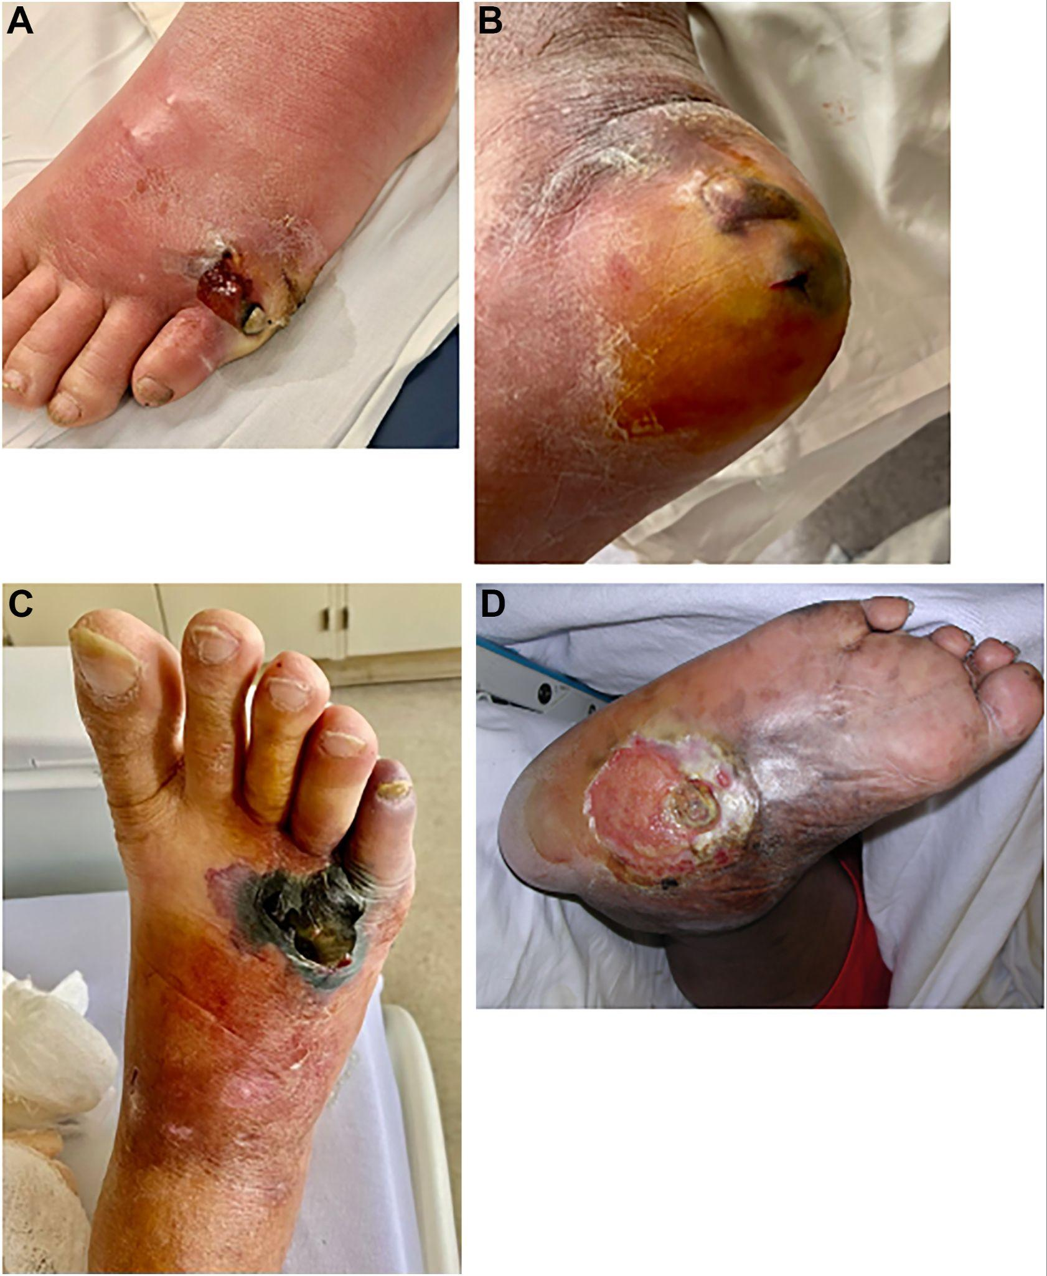
Frazee, B. W. (2024). Diabetic foot infections in the emergency department. Emergency Medicine Clinics of North America, 42(2), 267–285. https://doi.org/10.1016/j.emc.2024.01.003

Slide 14
Good news!!! - most of the complications are preventable

Slide 15
Low Blood sugar/ hypoglycemia symptoms
-patients on insulin, glyburide, gliclazide
-blood sugar <3.9 mmol/L
Shaky/ Trembling
Sweating
Confusion
Drowsiness

Slide 16
What to do when sugar is low?
Eat 15 grams of fast sugar
Recheck in 15 min
Always carry sugar source
Higher risk of low blood sugar if you are on insulin or sulfonylureas (ie. glyburide)

Slide 17
Management of Diabetes
Lifestyle Modifications:
Healthy Eating
Activity
Weight management

Slide 18
Management of Diabetes
Pharmacologic/ Medications:
Oral medications (metformin, empagliflozin)
Non-insulin injections (semaglutide, tirzepetide)
Insulin

Slide 19
Healthy Eating
nutrient-dense eating approach, Avoid processed foods
Utilizing the plate method (1/2 non-starchy vegetables, 1/4 protein, 1/4 starch)
consistent meal timing.
prioritizing whole foods, choosing low-glycemic carbohydrates, increasing fiber intake, and using healthy fats

Slide 20

Canada Food Guide Plate
1/2 non-starchy vegetables
1/4 protein
1/4 starch)
https://food-guide.canada.ca/en/tips-for-healthy-eating/make-healthy-meals-with-the-eat-well-plate/

Slide 21
Physical Activity
At least 150 min per week of aerobic activity (walking, cycling, jogging)
Improves glucose control and facilitates weight loss
At least 2-3 sessions per week of strength training

Slide 22
Foot Care
Check feet daily
Don't walk barefoot
Proper footwear
Report foot sores early

Slide 23
Preventing Complications
Yearly eye exam
Kidney test
Foot Checks
Blood pressure control
Cholesterol management

Slide 24
Myths About Diabetes
It is caused by eating sugar
Insulin means you failed
You can’t eat fruit
“If feel fine so I do not have diabetes”

Slide 25
Key Take Home Points
Diabetes is a common, long term condition
Unmanaged diabetes can lead to long term complications
Lifestyle modifications are first line treatment
Healthy eating and exercise are foundation of diabetes care

Slide 26
References
Diabetes Canada. (2018). 2018 clinical practice guidelines for the prevention and management of diabetes in Canada. Canadian Journal of Diabetes, 42(Suppl 1), S1–S325. https://doi.org/10.1016/j.jcjd.2017.10.001
Health Canada. (2025, March 31). Make healthy meals with the Eat Well Plate. Canada's Food Guide. https://food-guide.canada.ca/en/tips-for-healthy-eating/make-healthy-meals-with-the-eat-well-plate/

